Slide 1

CS1011 Computer Programming in Python
Lecture 1:Introduction to Computer Science and Programming in Python

Slide 2
Essential References
Guttag, John. Introduction to Computation and Programming Using Python: With Application to Understanding Data Second Edition. MIT Press, 2016. ISBN: 9780262529624.
Mark Lutz (2025). Learning Python, 6th Edition. Publisher(s):O'Reilly Media, Inc. ISBN: 9781098171308
Zelle, J. M. (2016). Python Programming: An Introduction to Computer Science. 3rd Edition. Franklin, Beedle & Associates Inc.
McKinney, W. (2022). Python for Data Analysis: Data Wrangling with Pandas, NumPy, and Jupyter. 3rd Edition. O'Reilly Media.
Grus, J. (2019). Data Science from Scratch: First Principles with Python. 2nd Edition. O'Reilly Media.

Slide 3
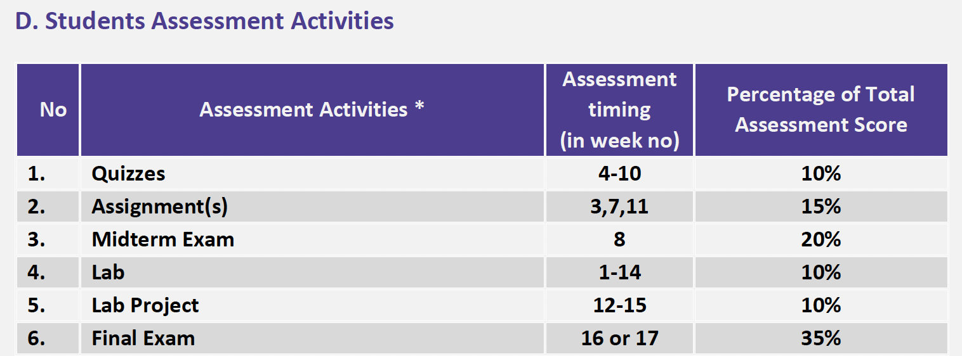
Assessment

Slide 4
Objectives
Introduction to computational thinking and problem solving
Introduction to Python and its ecosystem
Mathematical Operations
Basic syntax: variables, keywords, and expressions
Data types: integers, floats, and strings
Basic input/output (print, input)

Slide 5
What is Computational Thinking (CT)?
Definition | Source
‘Computational thinking is the thought processes involved in formulating a problem and expressing its solution(s) in such a way that a computer—human or machine—can effectively carry out.’ | (Wing, 2014)
‘The mental activity for abstracting problems and formulating solutions that can be automated.’ | (Yadav et al., 2014)
‘The process of recognising aspects of computation in the world that surrounds us and applying tools and techniques from Computer Science to understand and reason about both natural and artificial systems and processes.’ | (Furbe, 2012)
’A mental orientation to formulating problems as conversions of some input to an output and looking for algorithms to perform the conversions. Today the term has been expanded to include thinking with many levels of abstractions, use of mathematics to develop algorithms, and examining how well a solution scales across different sizes of problems.’ | (Denning, 2009)

Slide 6
The Software Development Process
The process of creating a program is often broken down into stages according to the information that is produced in each phase.

Slide 7
The Software Development Process
Analyze the Problem
Figure out exactly the problem to be solved. Try to understand it as much as possible.

Slide 8
The Software Development Process
Determine Specifications
Describe exactly what your program will do.
  Don’t worry about how the program will work, but what it will do.
  Includes describing the inputs, outputs, and how they relate to one another.

Slide 9
The Software Development Process
Create a Design
  Formulate the overall structure of the program.
  This is where the how of the program gets worked out.
  Develop your own algorithm that meets the specifications.

Slide 10
The Software Development Process
Implement the Design
  Translate the design into a computer language.
  In this course we will use Python.

Slide 11
The Software Development Process
Test/Debug the Program
  Try out your program to see if it works.
  If there are any errors (bugs), they need to be located and fixed. This process is called debugging.
  Your goal is to find errors, so try everything that might “break” your program!

Slide 12
The Software Development Process
Maintain the Program
  Continue developing the program in response to the needs of your users.
  In the real world, most programs are never completely finished – they evolve over time.

Slide 13
Example Program: Temperature Converter
Analysis – the temperature is given in Celsius, user wants it expressed in degrees Fahrenheit.
Specification
  Input – temperature in Celsius
  Output – temperature in Fahrenheit
  Output = 9/5(input) + 32

Slide 14
Example Program: Temperature Converter
Design
  Input, Process, Output (IPO)
  Prompt the user for input (Celsius temperature)
  Process it to convert it to Fahrenheit using F = 9/5(C) + 32
  Output the result by displaying it on the screen

Slide 15
Example Program: Temperature Converter
Before we start coding, let’s write a rough draft of the program in pseudocode
Pseudocode is precise English that describes what a program does, step by step.
Using pseudocode, we can concentrate on the algorithm rather than the programming language.

Slide 16
Example Program: Temperature Converter
Pseudocode:
  Input the temperature in degrees Celsius (call it celsius)
  Calculate fahrenheit as (9/5)*celsius+32
  Output fahrenheit
Now we need to convert this to Python!

Slide 17
Example Program: Temperature Converter
# Celsius to Fahrenheit Converter
# Take input from the user
celsius = float(input("Enter temperature in Celsius: "))
# Convert to Fahrenheit
fahrenheit = (celsius * 9/5) + 32
# Display the result
print(f"{celsius}°C is equal to {fahrenheit}°F")
Notes:
Python Programming, 3/e
17

Slide 18
Example Program: Temperature Converter
Once we write a program, we should test it!
Enter temperature in Celsius: 34.5
34.5°C is equal to 94.1°F

Slide 19
What is Python?
  Python is a general-purpose programming language
  It was released in 1991
  It supports multiple programming paradigms such as object-oriented

Slide 20
Why Python?
Works on different operating systems
Has a simple syntax
Its code can be executed as soon as it is written

Slide 21
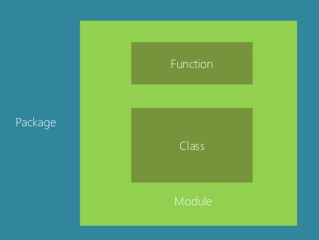
Python Components
  Functions
  Classes
  Modules
  collection of functions & classes
  Packages
  collection of modules

Slide 22
Mathematical Operations
Operator | Meaning | Example | Y
+ | Addition | x= 10 y = x + 3 | 13
- | Subtraction | x= 6 y = x – 4 | 2
* | Multiplication | x= 2 y = x * 5 | 10
/ | Division | x= 10 y = x / 7 | 1.4
% | Modulus (reminder) | x= 10 y = x % 7 | 3
** | Exponent | x= 3 y = x ** 3 | 27

Slide 23
Variables
  A variable is a named location in the memory that can store a value
  A variable is created when you first assign a value to it
  Variables do not need to be declared with a type & can even change type after they have been set
  A variable that has been given a value can be used in expressions
  Syntax:
  variable_name = value

Slide 24
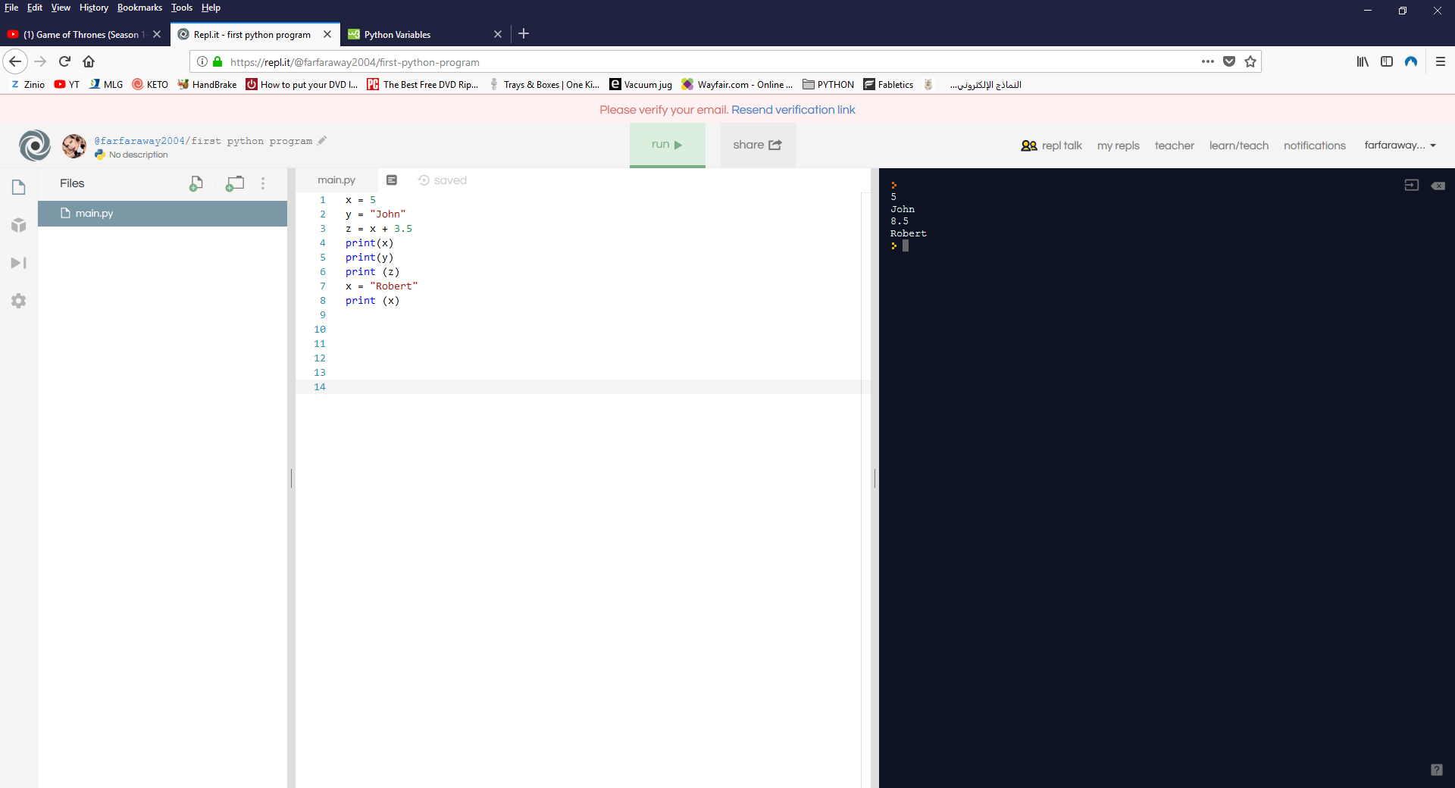
Variables

Slide 25
Variables: Names Rules
A variable name must start with a letter or _
A variable name can only contain numbers, letters, and _
Variable names are case-sensitive (age ≠ Age ≠ AGE)
A variable name can't be a keyword (see below)

Slide 26
Variables: Names Rules
Variable Name | Status
1st_num | x
Buffer_20 | √
_city | √
std id: | x
sum&avg | x
import | x

Slide 27
Constants
  A constant is a variable whose value cannot be changed
  To distinguish between a variable & a constant, programmes used to write constants in all capital letters and underscores separating the words
  Constants follow the same naming rules of variables
  Syntax:
  CONSTANT_NAME = value

Slide 28
Constants
Constant Name | Status
1st_num | x
BUFFER-20 | x
_CITY | √
STUDENT_NAME | √
SUM&AVG | x
RATE | √
  In the following table, which constant names violate/conform to the naming rules & programmers style

Slide 29
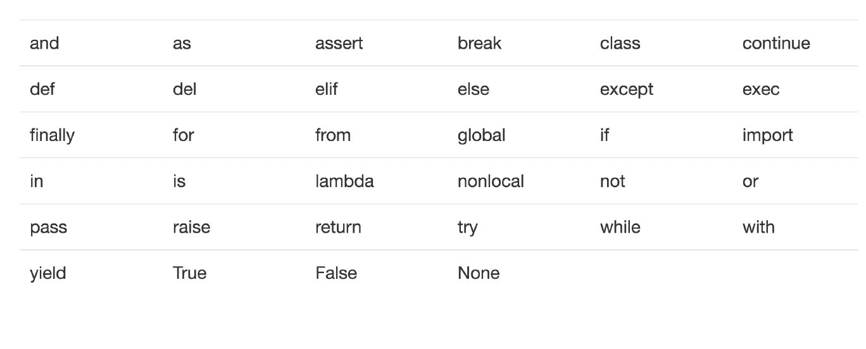
Keywords
  Some identifiers are part of Python itself. These identifiers are known as reserved words (or keywords). This means they are not available for you to use as a name for a variable, etc. in your program.

Slide 30
Expressions
You can produce new data (numeric or text) values in your program using expressions
x = 2 + 3
print(x)
5
print(5 * 7)
35
print("5" + "7")
57
This is an expression that uses the
addition operator
This is another expression that uses the
multiplication operator
This is yet another expression that uses the
addition operator but to concatenate (or glue)
strings together

Slide 31
Data types: integers, floats, and strings
Data Type | Example
Integers | 12
Floats | 2.75
Strings | Hello friends
Booleans | one of two values: True or False

Slide 32
input/output (print, input)
  The input() method asks the user for input and returns it
  Its important to assign the input() method to a variable to store the input data
  The print() function prints the specified message to a standard output device
  The print() uses the comma ( , ) to concatenate separate arguments passed to it, and it inserts a single space between them so that you don’t end up with a squashed message
  Syntax:
  Variable_name = input(“prompt message”)

Slide 33
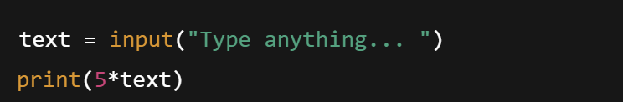

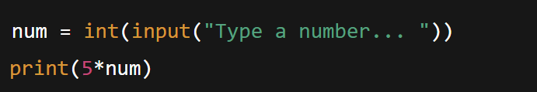

input (input)
Prints whatever is in the quotes
User types in something and hits enter
Binds that value to a variable
                # output
`input` gives you a string, so must cast if working with numbers
# output

Slide 34
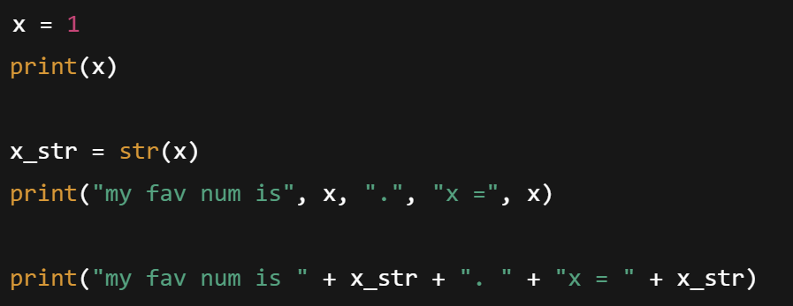
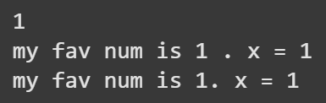
Output (print)
Used to output stuff to console
keyword is print
                #output

Slide 35
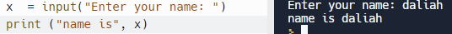
Example
Ask for the user's name and print it

Slide 36
Conversion Functions: int(), float()
  int() function: converts from a string (or a float) to an integer
  float() function: converts from a string (or an integer) to a float
  These functions are very useful with the input() method. The input() method returns the user input as string even if the data are numbers. Thus, use float() or int() after entering numeric data

Slide 37
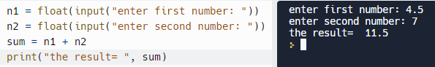
Example
  Add two numbers and print the result

Slide 38
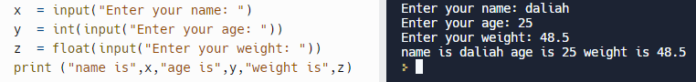
Example
  Ask for the user's name, age, weight and print it

